Slide 1
Op Amp Specs and Test Benches

Slide 2
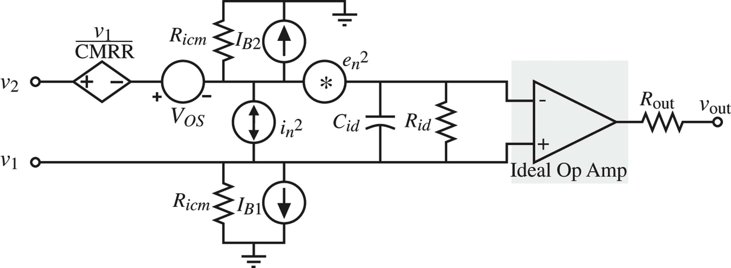

Slide 3
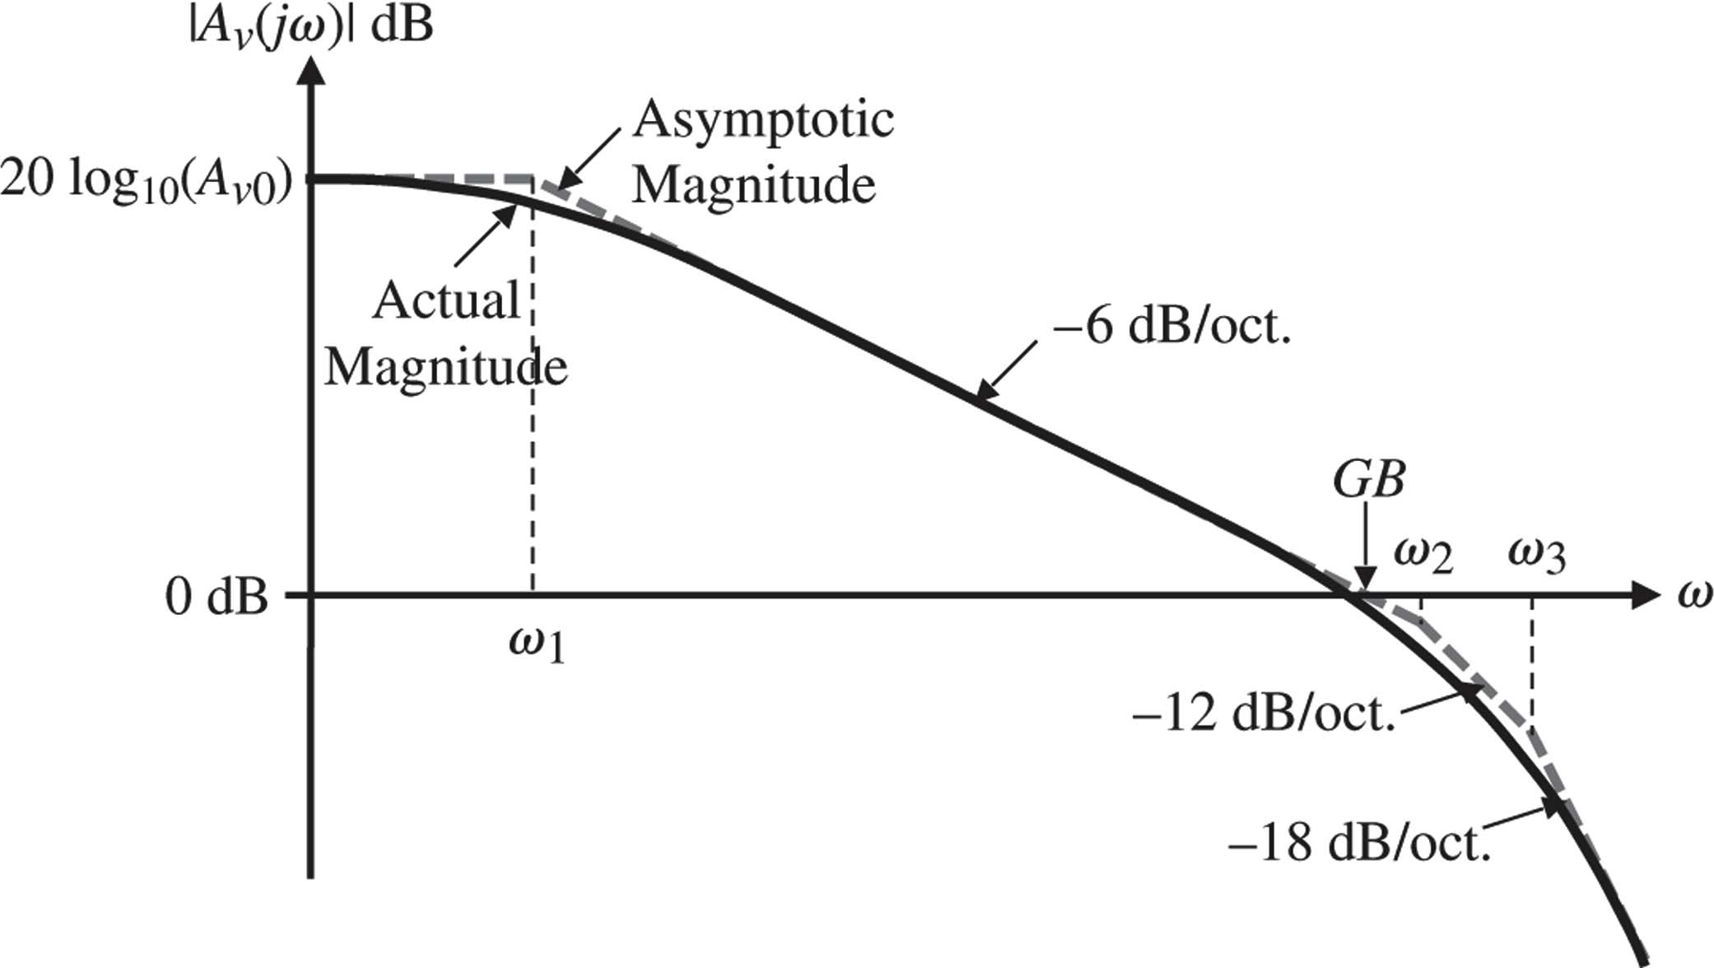

Slide 4
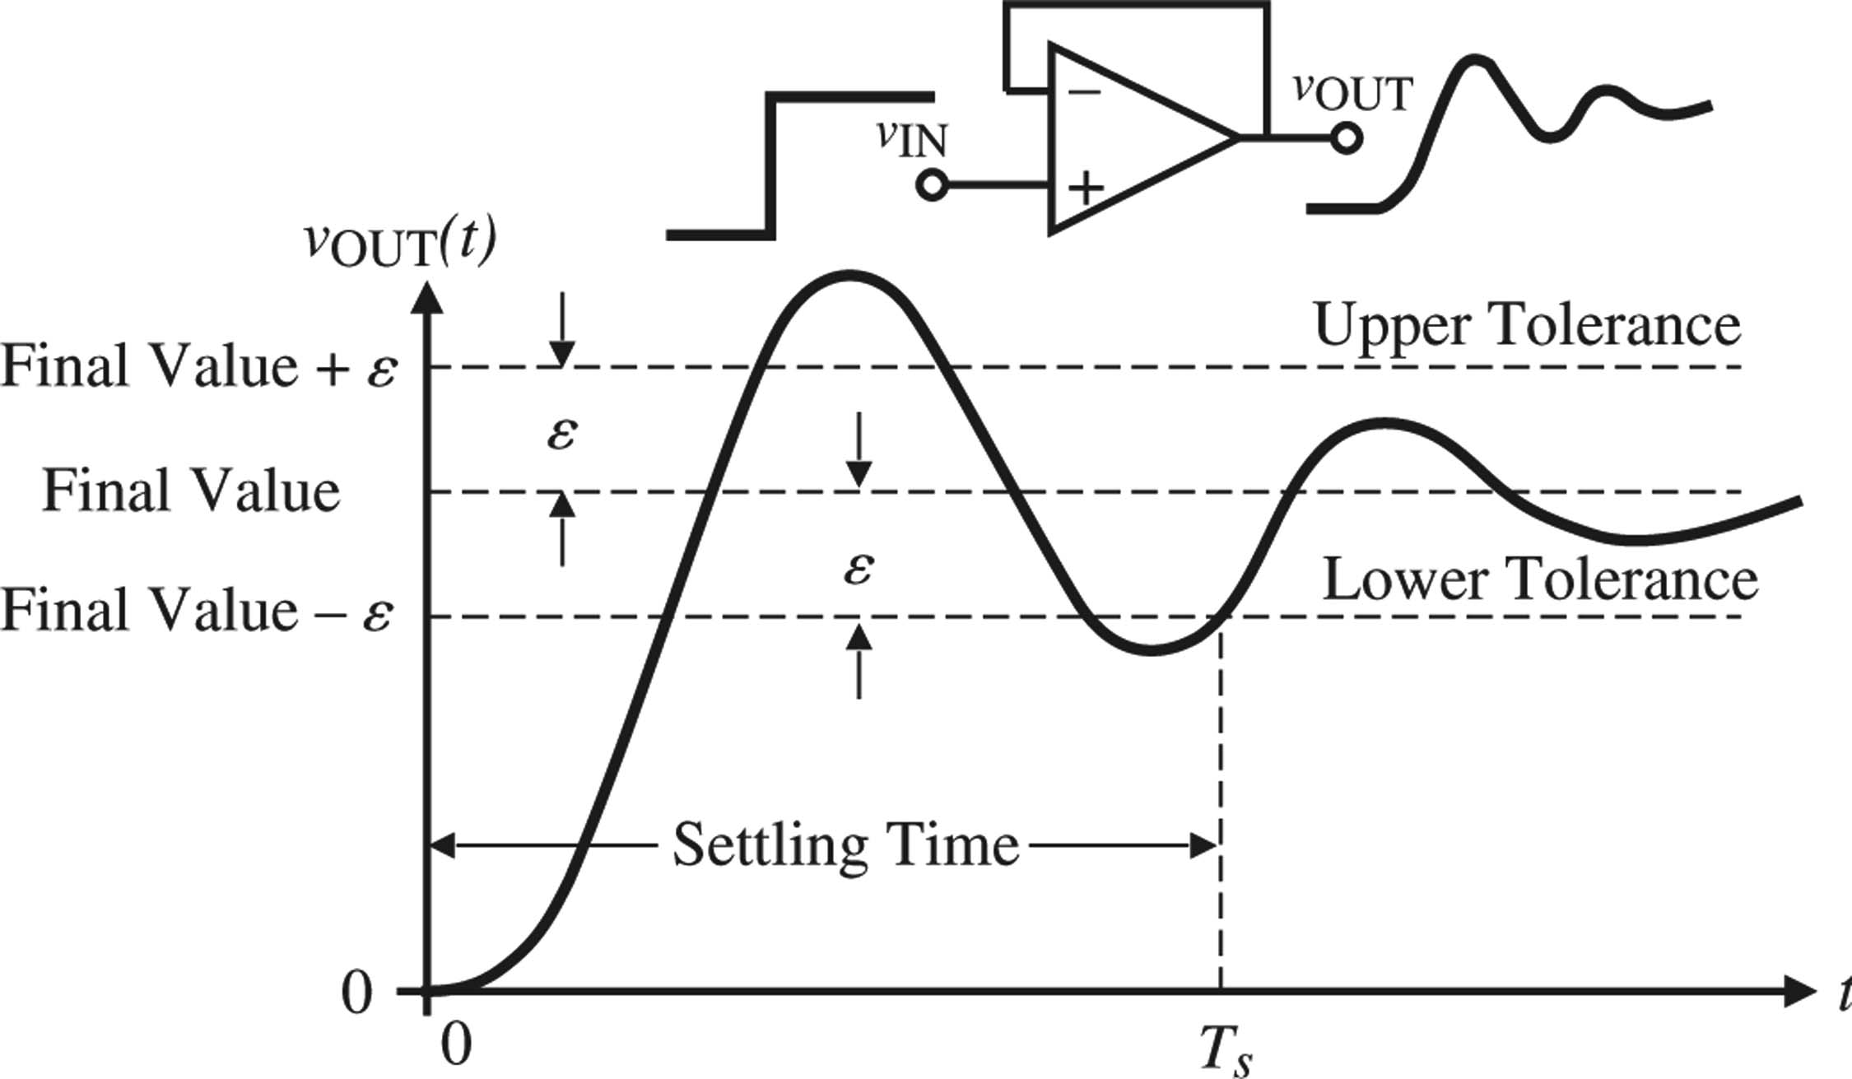

Slide 5
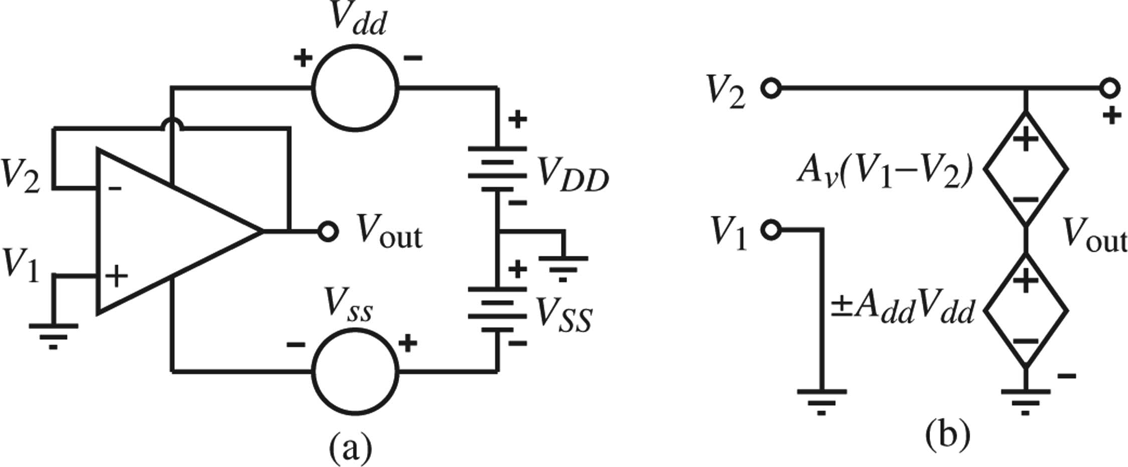

Slide 6
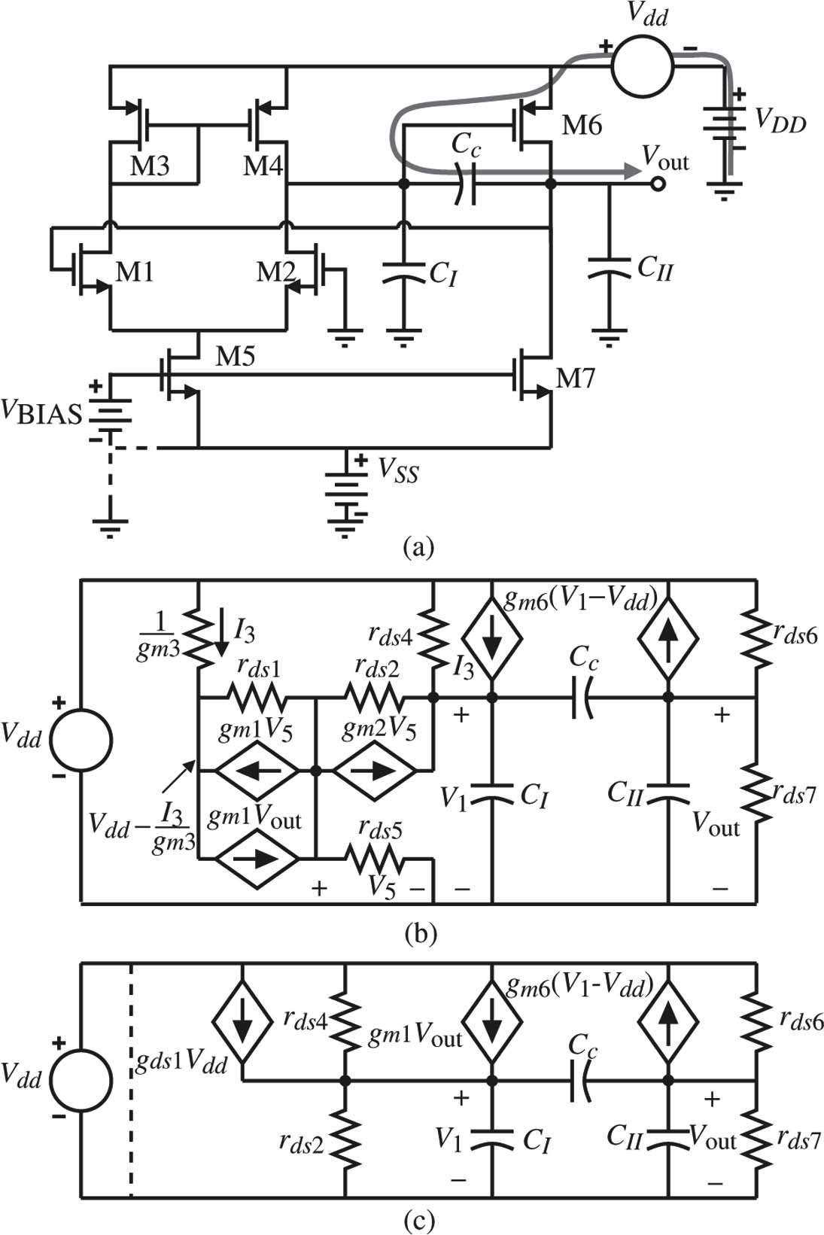

Slide 7
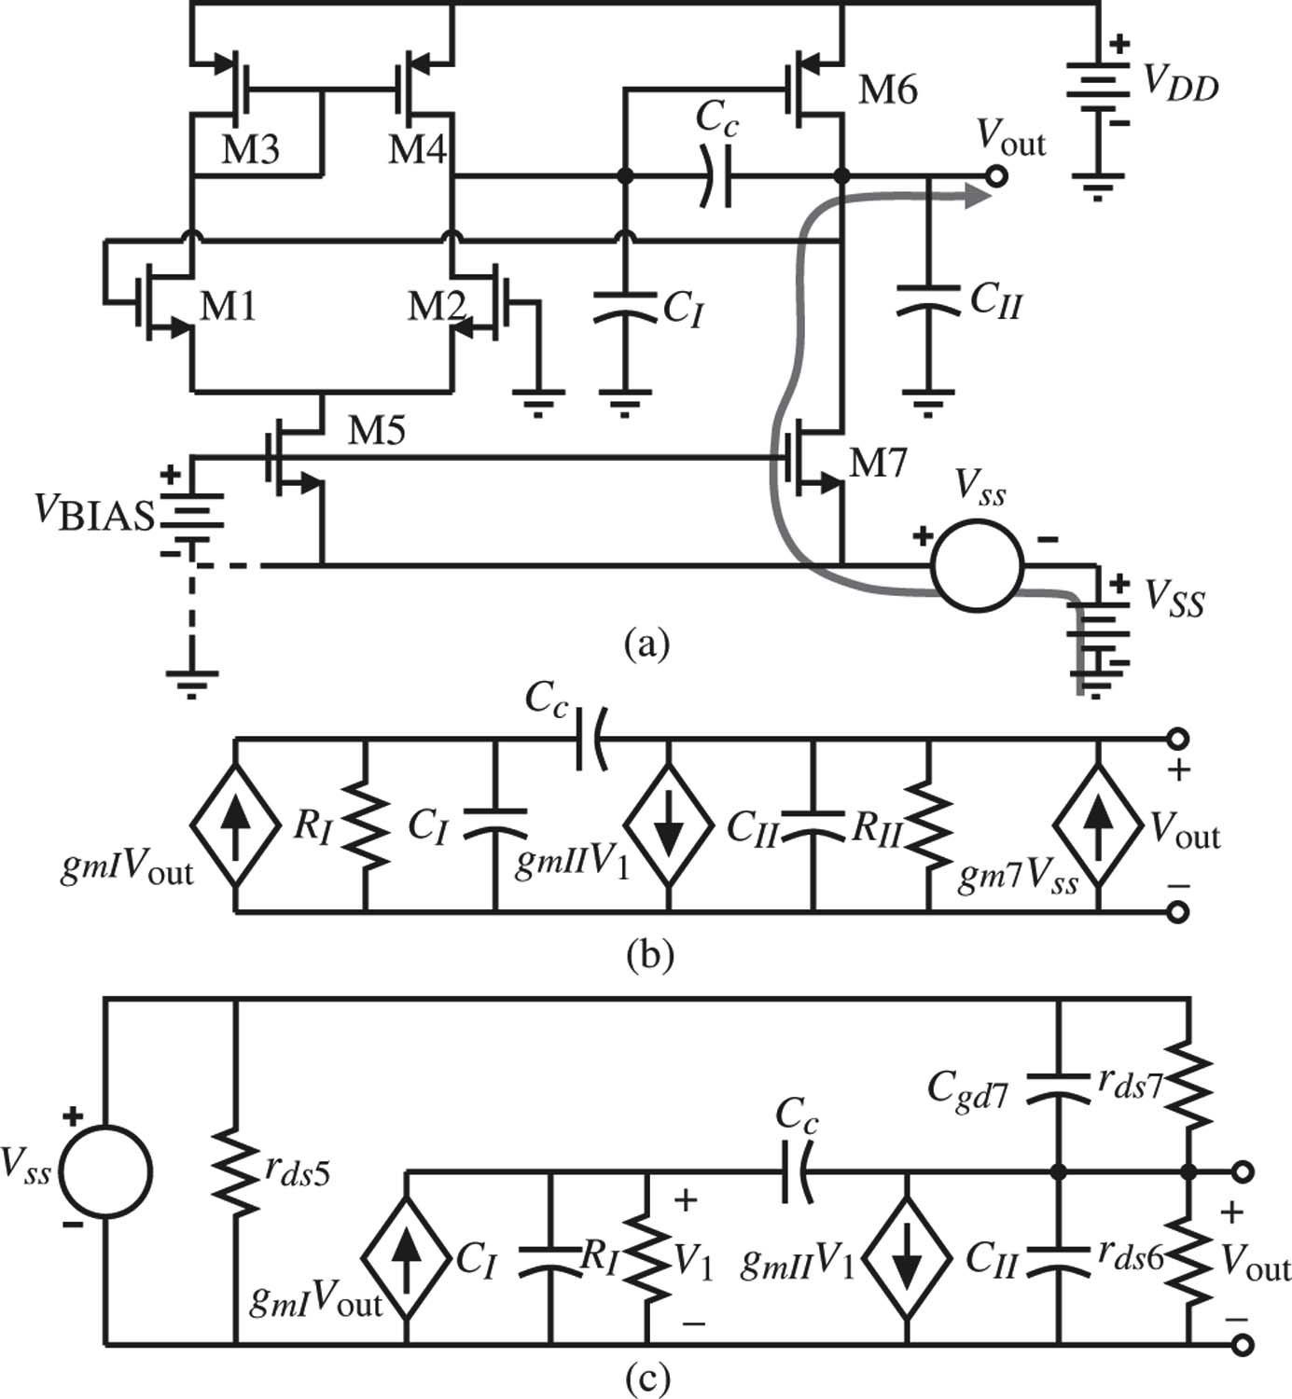

Slide 8
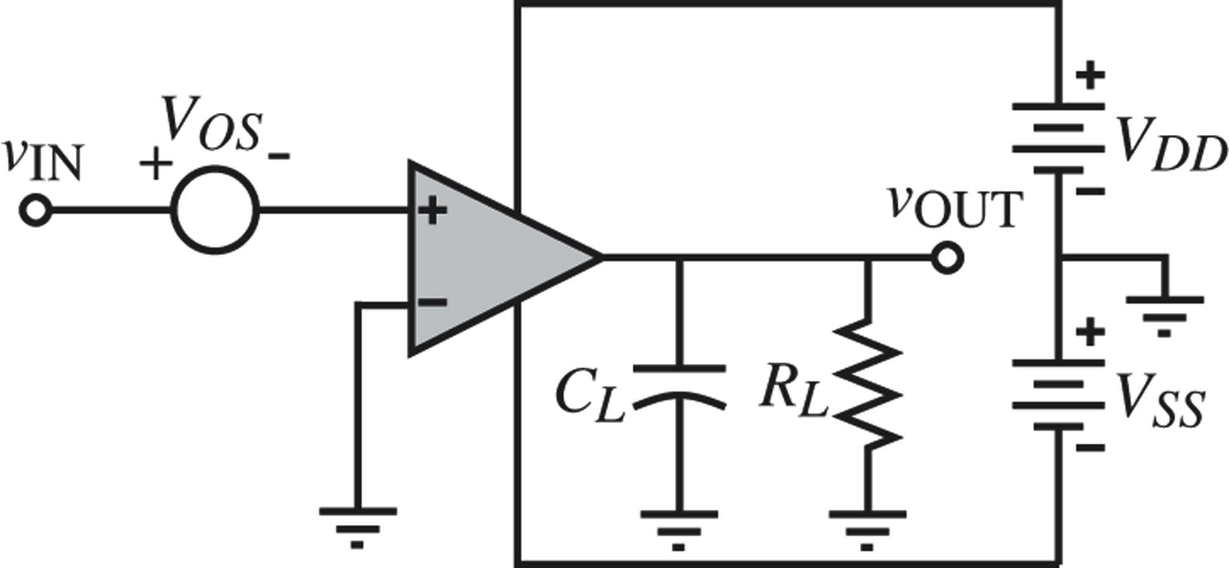
For simulation: book

Slide 9
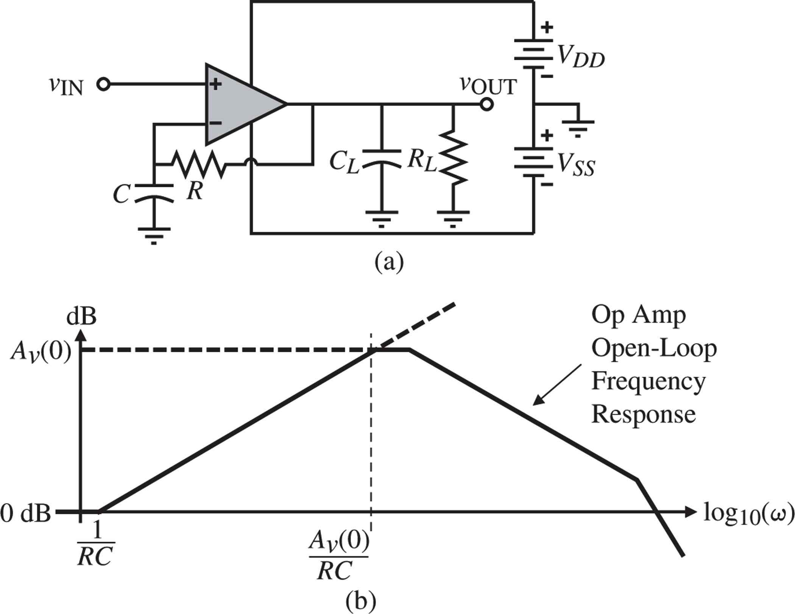
For measurement: book

Slide 10
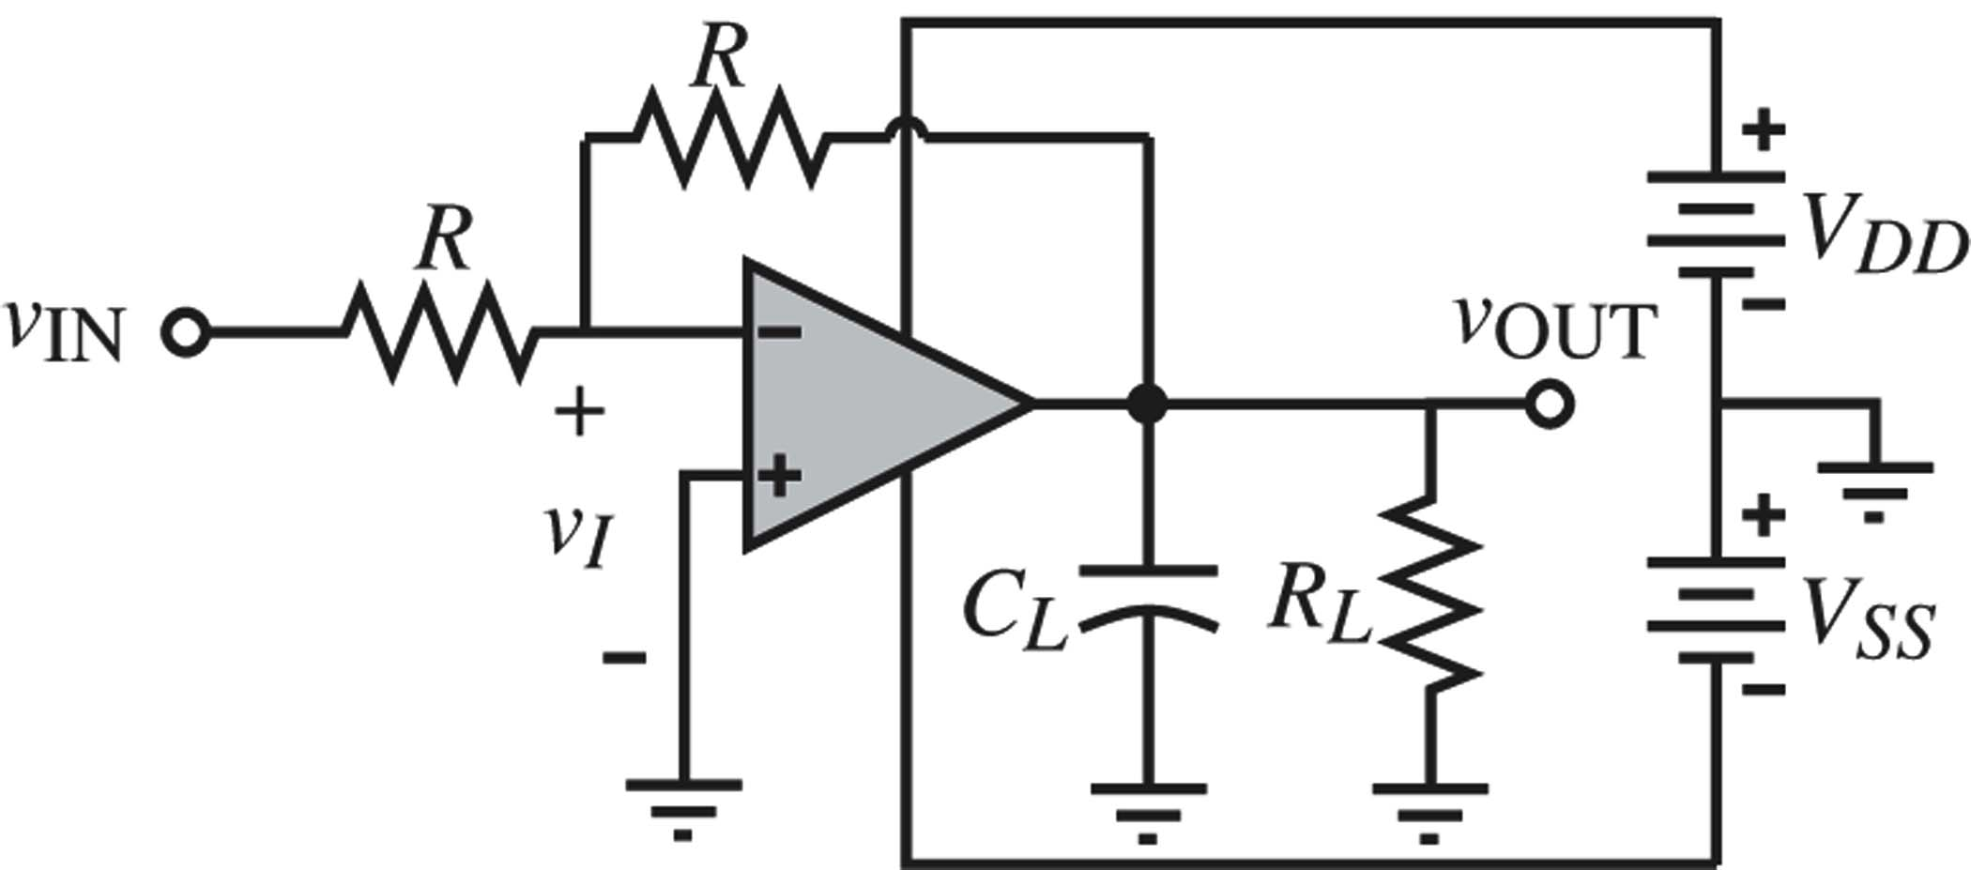
Low gain sim and meas

Slide 11
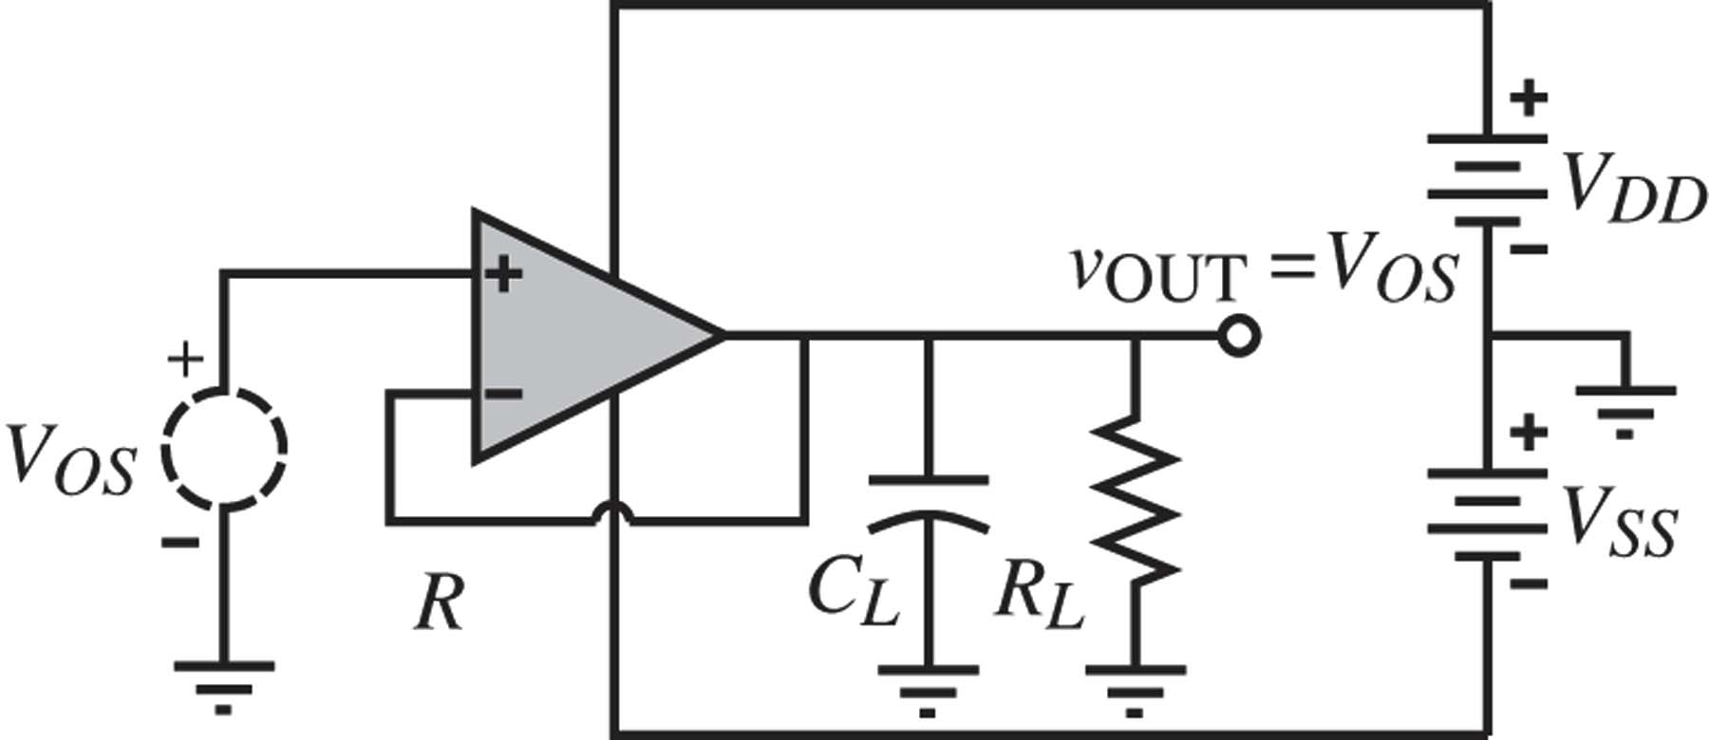
Sim and meas for low gain

Slide 12
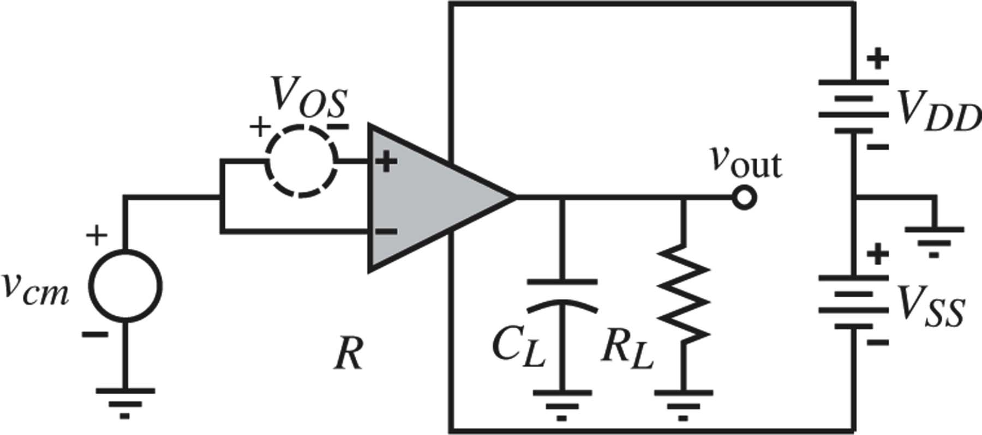
Figure 6.6-5 Configuration for simulating the common-mode gain.

Slide 13
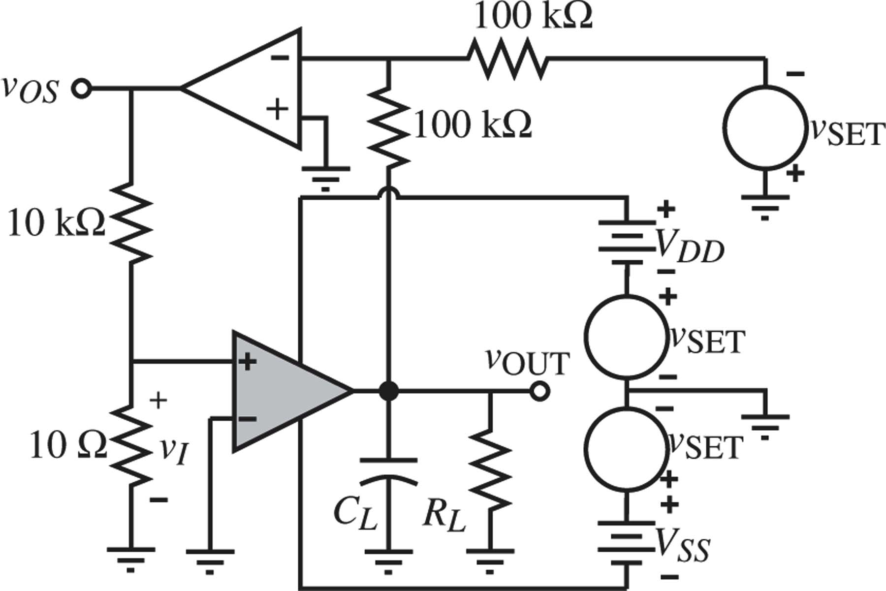
Figure 6.6-6 Circuit used to measure CMMR and PSRR.

Slide 14
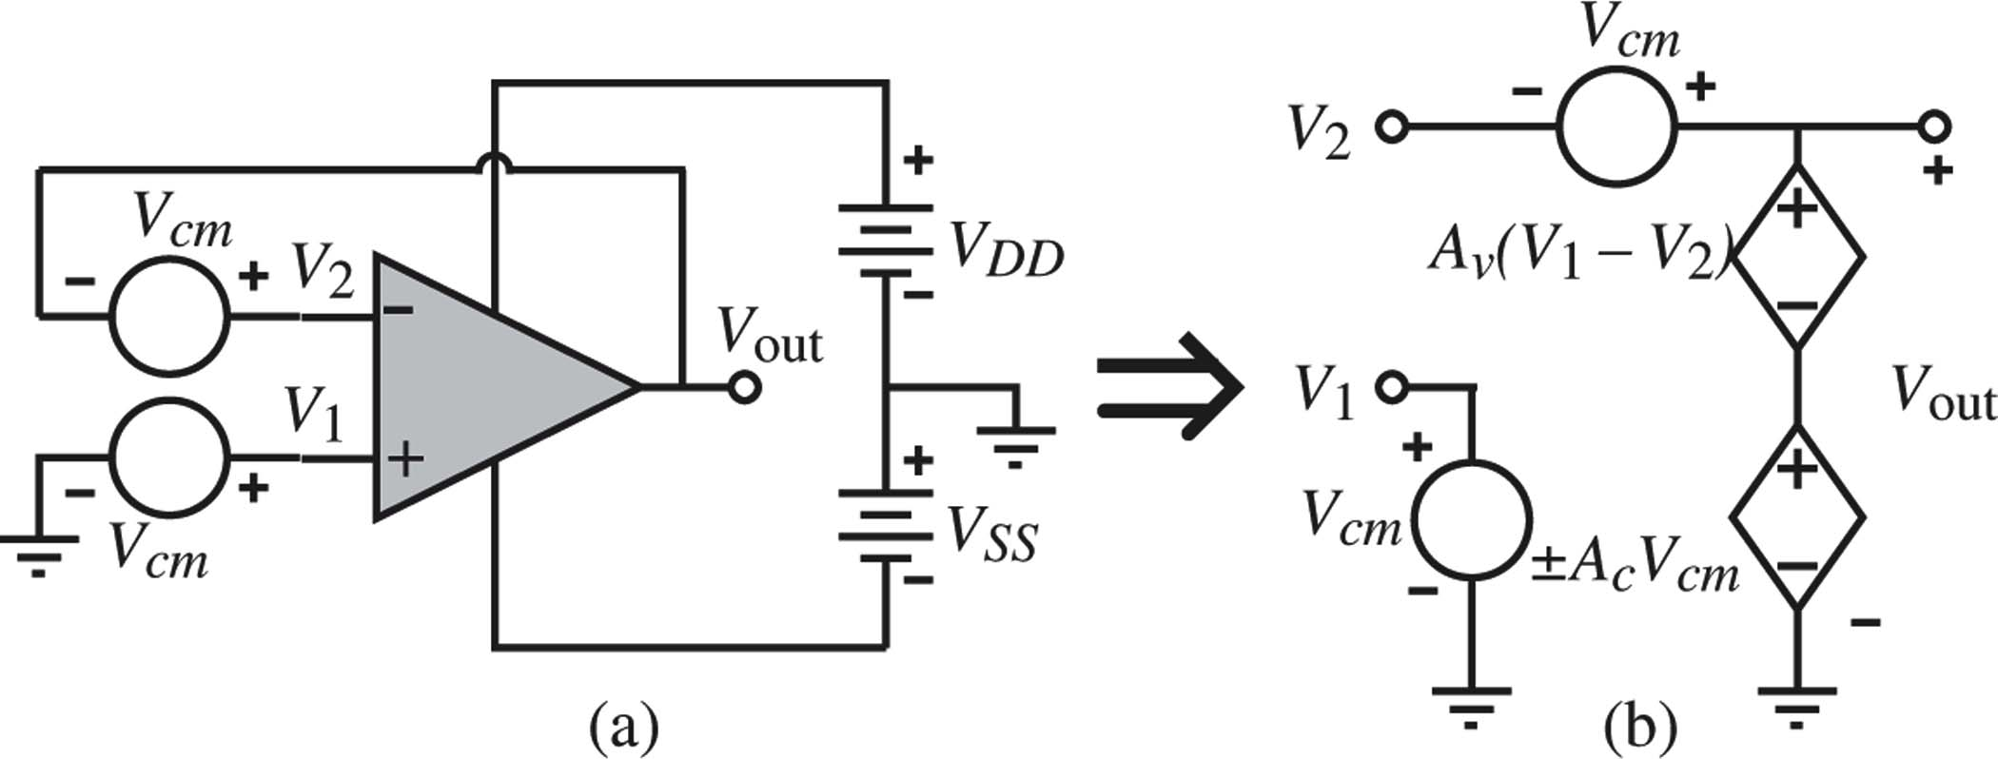
Figure 6.6-7 (a) Configuration for the direct simulation of CMRR. (b) Model for (a).

Slide 15
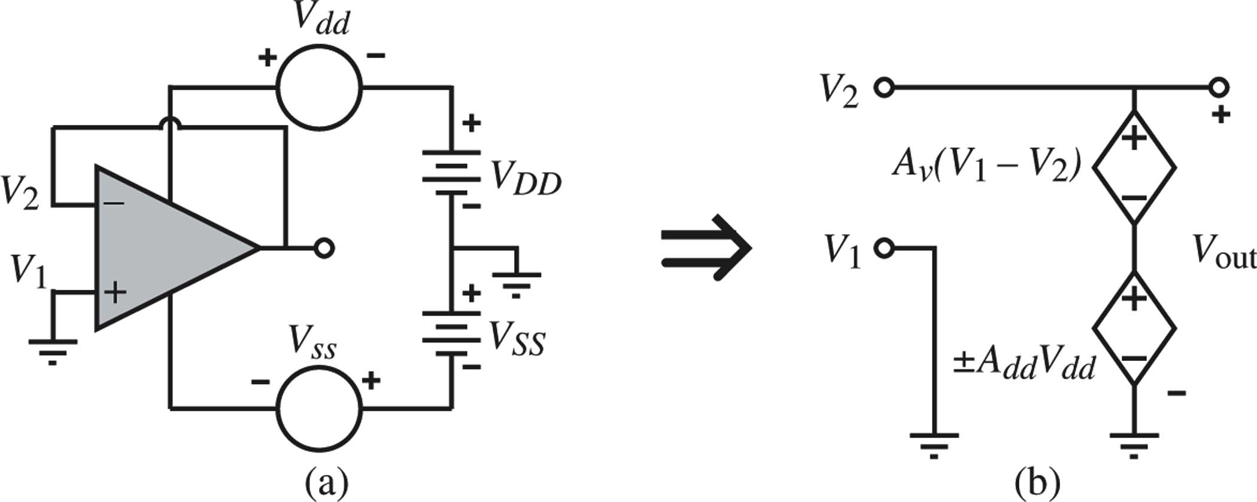
Figure 6.6-9 (a) Configuration for the direct simulation or measurement of PSRR.
(b) Model of (a) with V_{SS} = 0.

Slide 16
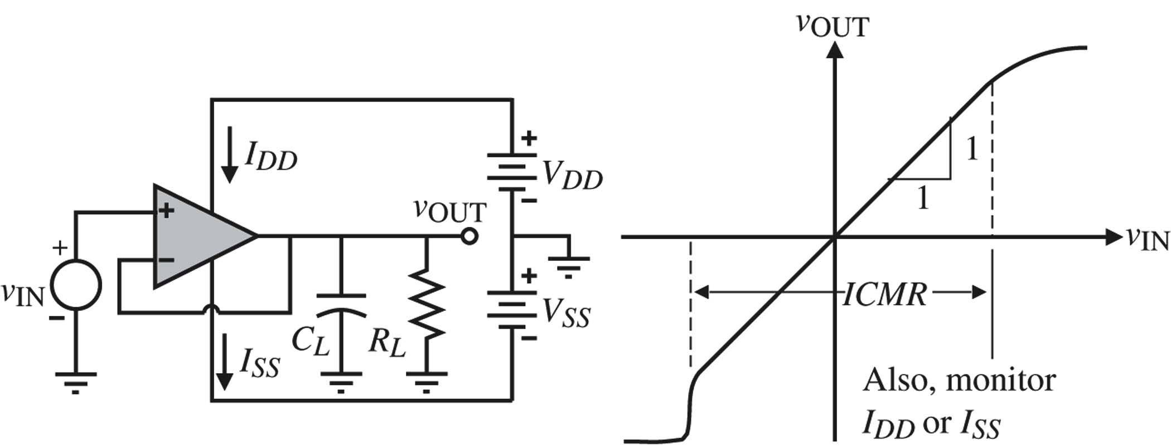
Figure 6.6-10 Measurement of the input common-mode voltage range of an op amp.

Slide 17
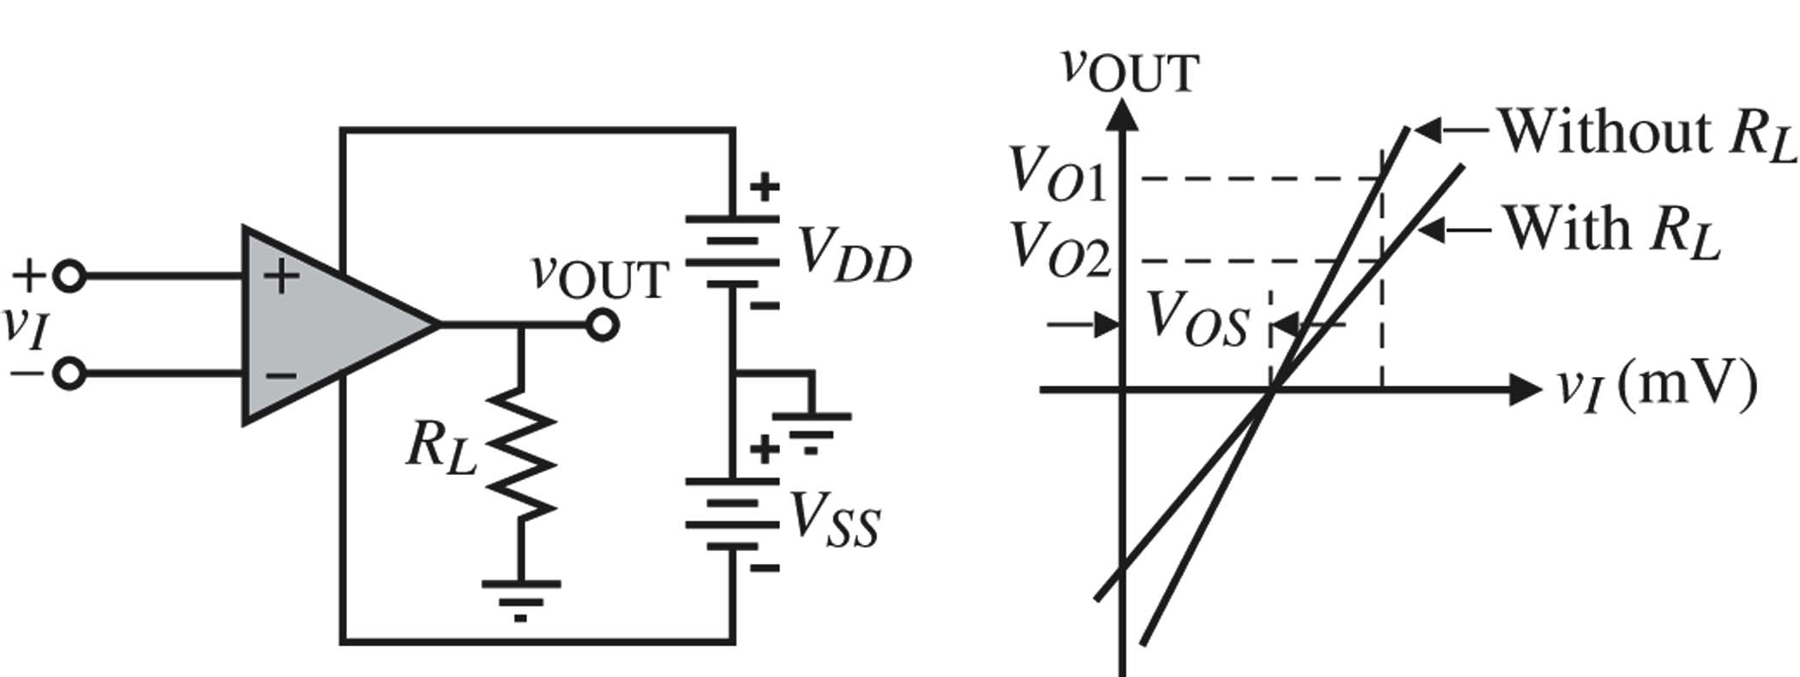
Figure 6.6-12 Measurement of the open-loop output resistance.

Slide 18
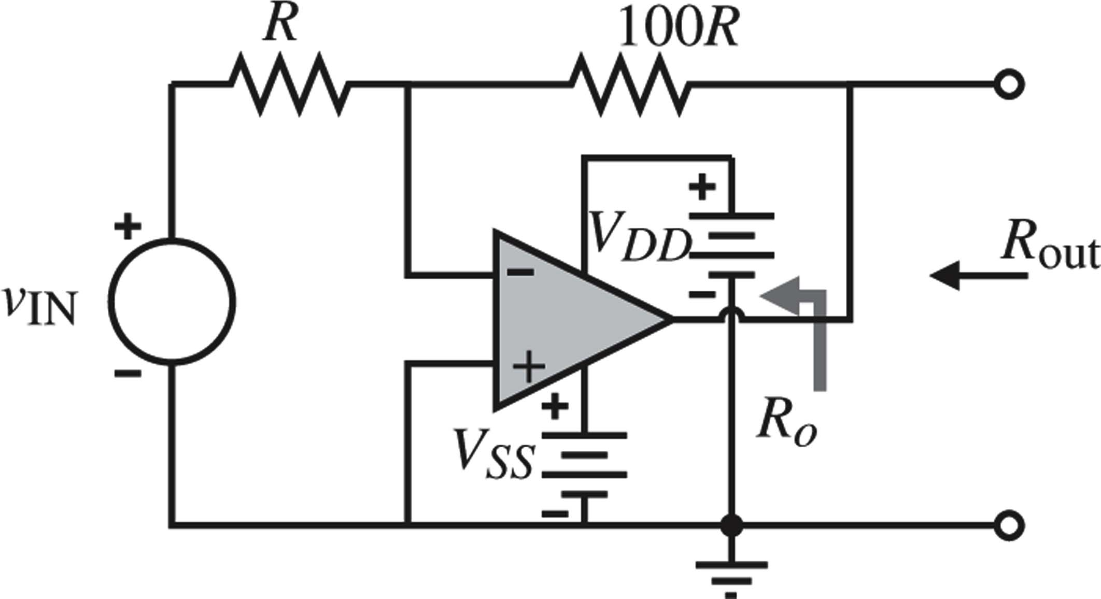
Figure 6.6-13 An alternative method of measuring the open-loop output resistance R_{O}.

Slide 19
Figure 6.6-14 Measurement of slew rate (SR) and settling time.

Slide 20
DC specs: Vos, IB1, IB2, Ricm, Rid, Rout, DC gain, DC CMRR, DC PSRR,
Actual Op Amp
DC large signal: input common mode range, output swing range, IDDQ; how these change with DC supply voltage, and with temperature

Slide 21
AC specs: open-loop AC gain/phase (Bode plot), loop transfer gain/phase with β-network, phase margin, gain margin, AC CMRR, AC PSRR

Slide 22
Transient specs: settling time, overshoot, slew rate, …

Slide 23
Testing Op Amps and Comparators
Daryl Hiser PA Op Amp -Test

Slide 24
Op Amps, Comparators, and Pattern Based Testing……oh my!

Slide 25
Outline
Basics of testing Op Amps.
The Loops
The Tests
Pattern Based Testing.
Basics of testing comparators.
Beware of flying monkeys! (common errors, issues, things to watch for)

Slide 26
Op Amp Loops
If you can measure Vos well, most of the Op amp test battle is won! PSRR, CMRR, AOL, Drift… are just looking for changes in Vos as some parameter is varied.
We use “test loops” to facilitate measurement and control of op amps during test. The loop gives local gain of the offset measurement.
This presentation will evaluate two useful loop methods: - False Summing Junction - Two Amp Loop

Slide 27
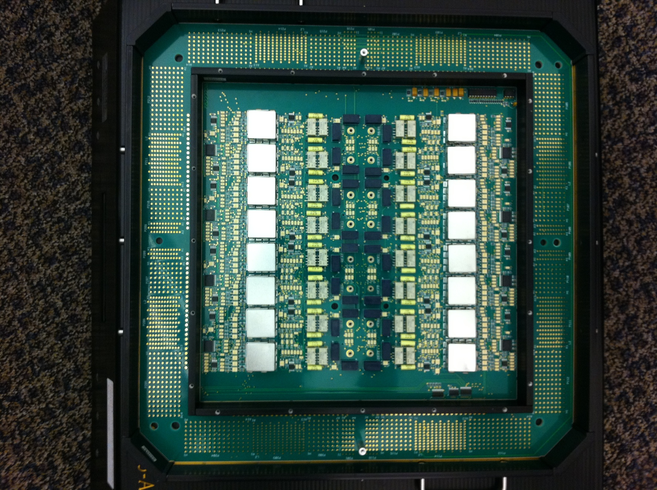
Eagle Op Amp HIB

Slide 28
Op Amp test loops
(False Summing Junction)
+10V
+ -
+ -
100 Vos
i = Vos / 1K
Vos
~ -10V
Offset Correction Factor = ACL + AFS
Vo = -(Vi + Vos(O.C.F))

Slide 30
Op Amp test loops
(False Summing Junction)
+10.302V
+10V
+ -
101mV
+ -
i2 = 98.99µA
i3 = 97.99µA
102.01µA
101.01µA
+
-
i1= 1µA
1mV
-9.698V
-10.0V
ACL = 200K/1K + 1 = 201
Offset Correction Factor = ACL + ASJ
Vo = -(Vi + Vos(O.C.F))
ASJ = 100K/1K + 1 = 101
OCF = 302

Slide 31
Op Amp test loops
(False Summing Junction)
The worse the DUT’s DC precision, the more significant loop errors become.
Pro’s
Simple
Stable
Small (4 tiny surface mount resistors and you can test everything but IB
Con’s
Feedback R is a Load
Loop drive a function of DUT Vos.

Slide 32
Pro’s
No Load Current
Loop drive is independent from DUT Vos
Op Amp test loops (2 Amp Loop)
Con’s
More complex
Requires Compensation!!
100 Vos
Type 2
i = Vos / 100
Vos
+10V
101 Vos
+10V
Type 1

Slide 33
Bode plot for 2 Amp Loop (uncompensated)
Combined response Both Amps
Closed loop Gain ACL
(100K/100) +1 = 1001
or ~ 60dB
Null Amp
ACL
40db/decade
closure!
DUT
Unstable !!!!!

Slide 34
Type 2 compensation
β=100/(100+100K||80pF)
=0.001(1+s100K80p)
=0.001(1+s/20KHz)
80pF
CF = 1 / (20KHz x 100KΩ x 2π) = 80pF
ACL
20db/decade
closure!
Stable !!!!!

Slide 35
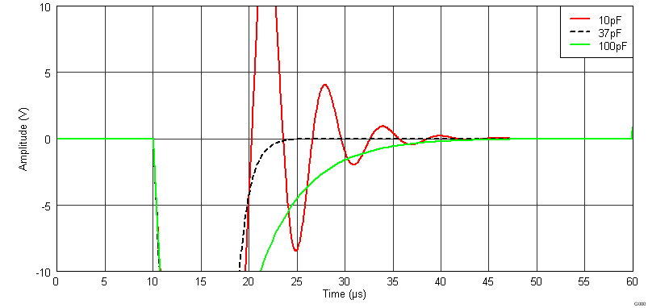
Type 2 compensation range
Lowest pole frequency
Optimum compensation
ACL
Highest pole frequency

Slide 36
Bode plot for Type 1 comp.
100pF
Closed loop Gain ACL
(100K/100) +1 = 1001
or ~ 60dB
Combined response Both Amps
ACL
20db/decade
closure!
DUT
Null Amp (integrator)
Stable !!!!!

Slide 37
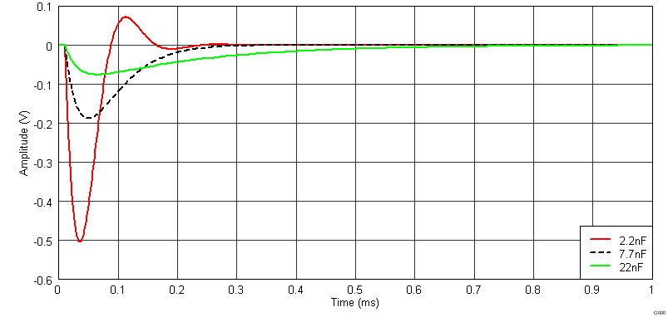
Type 1 Compensation Range
Intersection of Combined response with Closed loop gain (ACL)
ACL
Null Amp(integrator) zero frequency
Optimum is intersection / 4

Slide 38
Optimizing compensation
You can make bode plots to find the best compensation for either method.
…Or You can use TINA spice and evaluate through simulation …
… Or

Slide 39
… use the easy button.
Type 1 compensation
Given Rf, Rin, Rc, BW1
Type II compensation
Given Rf, Rin, BW1, BW2:

Slide 40
Op Amp testing basics
Key Parameters Abbr.
Continuity / Contact resistance Cres
Quiescent Current IQ
Input offset voltage VOS
Power Supply Rejection PSRR
Common Mode Rejection CMRR
Open Loop Gain AOL
Short circuit current ISC
Slew Rate SR
Gain Bandwidth GBW
Input Bias current IB
Noise
Total Harmonic Distortion THD

Slide 41
Continuity ***1 current ***
Continuity is measured by sourcing a small current (100uA typ.) through each IO pin through the ESD diodes to the positive supply, and then sinking current through the diodes connected between the IO pins and the negative supply. This verifies all ESD diodes are connected as well as all wire bonds intact and some contact to each pin.
i1 = 100µA
i1 = 100µA
41

Slide 42
Contact Resistance ***2 currents***
CRES is measured between each supply and the output using 10mA and 15mA currents to get past the diode I/V knee. It is a bulk resistance includes 2 contact resistances and the internal diode resistance.
i1 = 10mA i2 = 15mA
Cres1 = (Rp1 + Rp2) = [(V1 – V2)/ (I1 – I2) ] – Rd1
Cres2 = (Rp2 + Rp3) = [(V1 – V2)/ (I1 – I2) ] – Rd2
Cres3 = (Rp1 + Rp3) = [(V1 – V2)/ (I1 – I2) ] – Rd3
Contact resistance > ~1Ω can be accounted for using this method. If 1Ω or less is a problem for measurements, Kelvin contacts should be used.
42

Slide 43
Complete Diode Equations
CRES and temperature ***3 currents***
i1 = 5µA i2 = 35µA i3 = 85µA
CRES and
Temperature
Temperature accuracy ~ ± 5°C with ESD diode

Slide 44
Quiescent current / Integrity / ISC
Iq = Iq(meas) – empty socket null
Output stage
1mA
1.5mA
ibias
iOUT = 1mA
1mA
0.5mA
One note of caution…beware of measuring load current by looking at the change from Quiescent current on the DUT supplies.
44

Slide 45
Vos / PSRR / CMRR
PSRR = ΔVos / ΔVcc (μV/V)
CMRR = ΔVos/ ΔVcm (μV/V)
If (Ib x RF)/100 is significant to Vos it must be considered!
ΔVcc
± CMV
ΔVee
Beware of oscillations… Op Amps “may” rectify low level oscillations because of input clamping diodes and this can appear as an erroneous offset voltage.
45

Slide 46
Example of big IB error on Vos measurement
In this configuration there is a 1µV / nA error on Vos.
The 2 Amp loop with same R values would have the same error!
= 150mV /loop gain = 1.5mV
50% error!!!
1.5µA
500nA
1µA
1mV
Smaller resistors reduce error. ie 10K and 100Ω would be 50uV error…
or Measure IB first and use it in Vos calculation.

Slide 47
CMRR considerations
0V
-4V
Moving supplies and output is equivalent to moving common mode voltage !
=
Remember that you can not short the inputs of an Op Amp together. Doing so will put it in the rail !!!
0V
4V
=
47

Slide 48
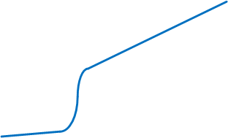
PSRR consideration for rail to rail amps
2.75 V
0.9 V
-0.6V
-0.6V
pMos to nMos transition
-2.75 V
-0.9 V
1.5V
CMV1
CMV2
0V
CMV2
CMV1
0.6V
-0.9V
0.9V
48

Slide 49
AOL / Swing / Slam
Aol = ΔVos / ΔVout (μV/V)
49

Slide 50
Swing Aol / Slam considerations
AOL Curve
Precision in drive for swing….”just enough”
Compare Vout to supplies…not ground
Remember R_{F} in || with R_{L} in FSJ

Slide 51
Slew Rate
2K
Slew of source must be faster than DUT
DUT slew should not be limited by parasitic RC’s
Some Op Amps are specified in unity gain…

Slide 52
Gain Bandwidth Product
GBP = test frequency * [Vout(rms) / Vos(rms)]
The test frequency should be 2x Unity Gain BW / loop gain

Slide 53
Bode plot of gain vs frequency
Open Loop
As frequency increases, parasitics may begin to dominate!
Loop 1K
Loop 100
Test frequency
LG = 1000
LG = 100
The higher bandwidth the greater the challenge!

Slide 54
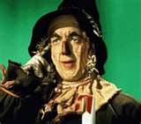
The dreaded iB test…
“It’s like trying to poke a cat out from under the porch with a rope”
-Unknown-

Slide 55
Some IB issues and challenges
µA down to fA
Stability
(Thermal EMFs)
Leakages
Humidity
Environmental noise
…

Slide 56
nanoAmps
for I_{B} greater than ~200pA
Ios = Ib+ - Ib- (math not measure)
Current into the input is “positive” by convention.
identical currents will produce opposite changes in “vos” measurement… Ib+ gets multiplied by -1.
I_{B} = ΔV / Loopgain / Rib

Slide 57
picoAmps
for I_{B} 5pA to ~200pA
I_{B} = C dV/dt / Loopgain

Slide 58
femtoAmps ~6 electrons / mSec
for I_{B} < 5pA
+V
-V
I_{B} = C dV/dt - null
***Facilitates nulling of leakage currents on empty socket calibration***

Slide 59
Step 1:
Run an open socket leakage test for each amplifier input and store values
Step 2:
Measure bias current of each input
Step 3:
Bias Current = I_{MEASURED} – I_{LEAKAGE}
I = C(dV/dt)
Leakage
∆V
Leakage + I_{B}
∆T

Slide 60
Important considerations for low IB measurements
Low leakage Capacitor ( Teflon, glass, polypropylene polystyrene).
Low thermal EMF cancelled, mechanical latching relays w/ active high drivers.

Slide 61
Thermal emfs are indistinguishable from Vos
Vos + emf
Vos
i = (Vos +emf)1K
Thermal emf

Slide 62
Thermal emfs
Thermal emfs outside this ring are divided by the loop gain!!!
Thermal emfs inside this ring cause 1:1 errors

Slide 63
Back to Low IB Active High vs Active Low drivers
Low thermal EMF cancelled, mechanical latching relays w/ active high drivers.
Active High Driver
Active Low Driver

Slide 64
Relay Drivers
12 V
12 V
Active High Drive
Open Collector
Ib
Ib
C int
COIL
C int
COIL
RELAY
RELAY

Slide 65
Relay Drivers
12 V
12 V
Active High Drive
Open Collector
Ib
Ib
C int
COIL
C int
COIL
RELAY
RELAY

Slide 66
Relay Drivers
12 V
12 V
Active High Drive
Open Collector
Ib
Ib
C int
COIL
C int
COIL
RELAY
RELAY

Slide 67
Relay Drivers
Actively High driven Latching relays reduce:
Leakage (Coil Voltage) during test. (Good for Low IB)
Heating (Coil current) during test (Good for Low Vos)
EMI (Coil B field) during test (Good for both)
Guard traces / Shielding
Exposed guard traces reduce surface leakage!
Active guarding can further reduce leakage but adds complexity

Slide 68
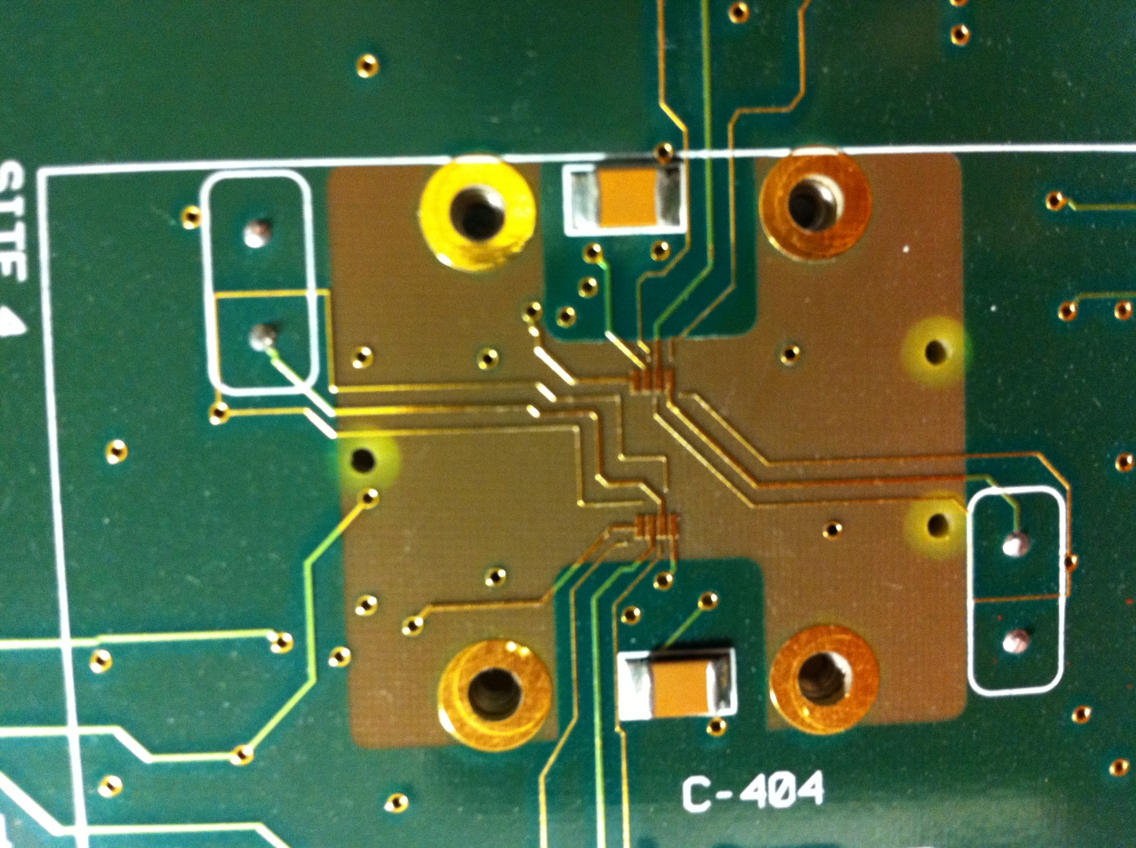
Guard traces / Shielding
High Z trace
Exposed Guard traces

Slide 69
Guard traces / Shielding
Internal Guarding and Shielding (cross section )
Protected trace
FR4 material
Ground planes
grounded guard traces

Slide 70
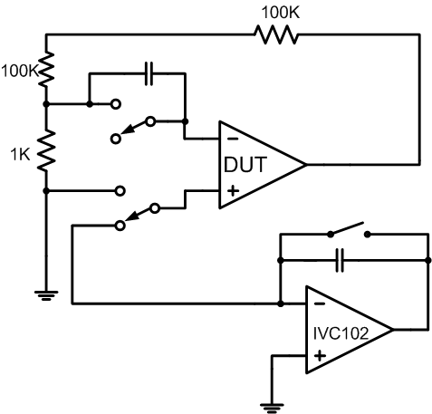
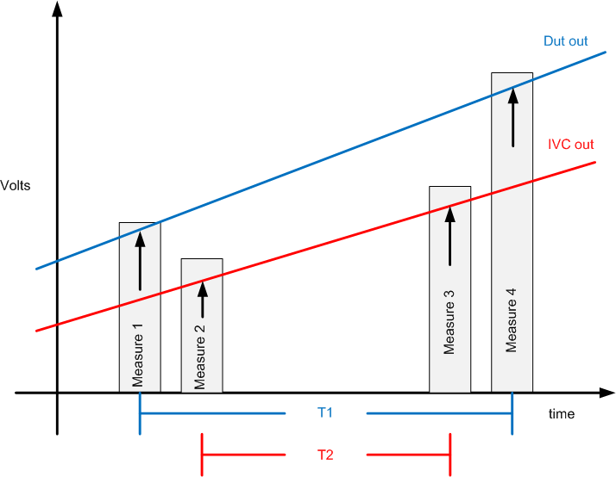
“Two for one”
~One integration time -> 2 ib measurements
Ibn = C [(M4 – M1) / T1]
Ibp = C [(M3 – M2) / T2]

Slide 71
Current Ib Test Investigation
We are designing an octal site board with a different Ib measurement experiment on each site for the purpose of improving our understanding and techniques.
We plan to contact our National counterparts to see if they have any helpful practices or techniques that we could leverage or adopt.
If you have any suggestions or ideas, I would love to hear them!!

Slide 72
Getting close…

Slide 73
Pattern Based Testing
What is pattern based testing?
Why bother?
How can you implement it?

Slide 74
PBT: Overview
Post-process data in DSP memories! Avoid *slow* data transfer!

Slide 75
Digging a bit deeper for Op Amp Testing
Predefined waveforms are generated.
One circuit configuration is selected that is most suitable for all tests
The output is digitized and stored
Digitized data is analyzed

Slide 76
Pattern Based Testing: Analysis
Typical Segment
Each test segment is composed of 2 elements:
Settling time
Measuring time
Analysis of the raw data will allow for correct time selection
This alone can reduce test times!
Settle
Measure

Slide 77
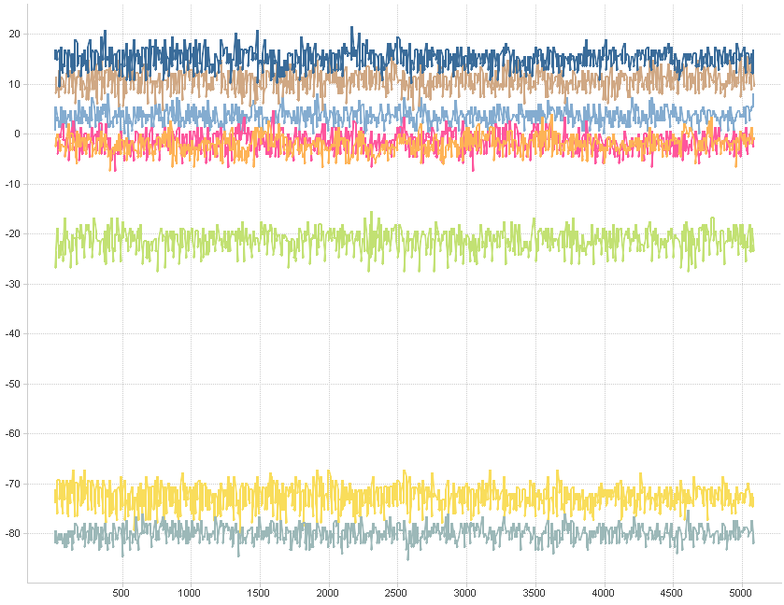
Raw data Analysis
Raw data analysis provides many of benefits
The current testing methodology would not show all of the raw data. Only 1 averaged point would be returned.
Debugging and verification can be improved by viewing the raw data!
Slight oscillation on some units. Adjust compensation.
Perfect!

Slide 78
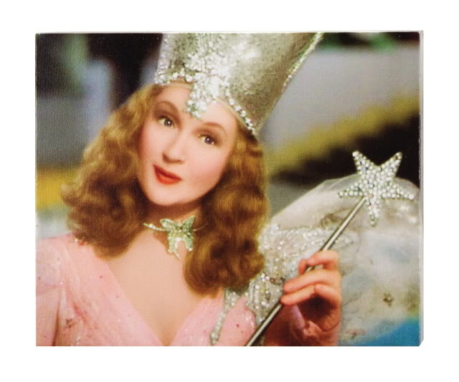
PBT Benefits
Reduced test time 1.5 seconds to 0.3 seconds
Reduced Test % of COB
More thorough coverage at probe and FT
Where do the time savings come from?

Slide 79
Quiz
On the Eagle tester, how long does it take 8 QMS’s grouped together to make a measurement if the number of samples is 100 and the sample time is 10uS?
qmsmv( QMS_GP, QMS_PREC, 100, 10 );
Answer: ~ 9mS

Slide 80
A comparison: Discrete vs PBT on ETS364’s
Action Group time cost
Control APU Group (Vcc) 8mS
Control APU Group (Vee) 8mS
Control APU Group (Vcm) 16mS
Control APU Group (Vout) 16mS
Control Dpins ?
Control Cbits ?
Settling time ?
Control QMS Group 8mS
~60mS x discrete setups ( 11 )
Total “Setup” Time 660mS
Action Group time cost
Control APU Group (Vcc) 8mS
Control APU Group (Vee) 8mS
Control APU Group (Vcm) 16mS
Control SPU Group (Vout) 16mS
Control Dpins ?
Control Cbits ?
Settling time ?
Control QMS Group 8mS
~60mS x patterns (1-4)
Total “Setup” Time 60 - 240mS

Slide 81
Future Work
Continue to refine the SW and analysis tools
Final Test implementation
Hardware improvements to support method
Expanding test coverage … Noise, Settling time, Drift?
Yazdi Contractor has done some outstanding work to provide standardized tools for PBT on the Eagle Test platform!!!

Slide 82
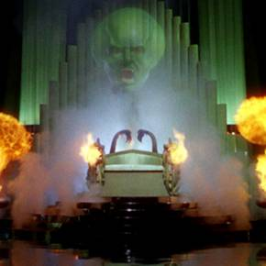
Comparators

Slide 83
Comparator Test
Continuity
Quiescent Current
Vos
Psrr
Cmrr
Output Swing
Output current
Bias Current
Slew Rate aka rise time/ fall time
Propagation delay
Hysteresis
Similar to Op amps, if you can measure Vos, you are most of the way there on comparators… and there are many ways to do this.
Most Comparators are not “stable” in a loop like an op amp.
No loop gain means precision Vos measurements need a different strategy.

Slide 84
Vos / PSRR / CMRR
Synchronous
Attenuator reduces AWG error (drift, offset, lsb)
and potentially noise.
*May need to buffer
and or filter.

Slide 85
Vos / PSRR / CMRR
Asynchronous
Just arm timer and run AWG

Slide 86
t1
t2
ΔV = 2 x propagation delay*
V1
Vin
ΔV
Vos
V2
*Propagation delay of “system”
Vos = (V1 + V2 ) /2
or
Vos = Vin(max) - (t2 – t1) /2 * dv/dt
Consider ramp speed and propagation delay vs test time!

Slide 87
Hysteresis
V1
Vin
Hysteresis
V2
A Vos measurement on a comparator with hysteresis requires a synchronous method or a one shot that is coupled to a sample and hold or triggers a measurement.

Slide 88
Propagation delay
Compare to shunt to make measurement “delta”
Limited by accuracy and or resolution of the timer / counter. ie QTMU accuracy is ~100pS with ~10pS resolution.
Trace lengths, attention to parasitics in layout become a big factor for fast prop times. Speed of the “fast edge” is also a factor. Many comparators have asymetric prop. delays

Slide 89
Propagation delay timing
PDH
PDL

Slide 90
Propagation delay A cool circuit that might work… a ring oscillator
shunt
RC determines the oscillation frequency.
Can measure the number of counts for fixed time period
or the time for fixed number of counts.
tPD = (time)/ Δcounts/2
tPD = Δtime/counts/2

Slide 91
TINA says “looks good”
Without Comparator in the loop:
Number of count (Nc): 2 ^ 8 (8-bit binary count)
Total Time (Tc): 40.99us
T1 (=Nc/Tc) 160.1ns (Calculated) 160.4ns (Measured)
With Comparator in the loop:
Number of count (Nc): 2 ^ 8 (8-bit binary count)
Total Time (Tc): 42.88us
T2 (=Nc/Tc) 167.5ns (Calculated) 170.8ns (Measured)
Prop Delay (T2 – T1)/2 = 3.7ns
Might be handy multisite testing where timing measurements need to be done serially!

Slide 92
Special Thanks:
Matt Picket and
Yazdi Contractor
For their work on PBT
THE END
hiser_daryl@ti.com

Slide 93
Questions?

Slide 94
Needs
Our implementation of Pattern Based testing utilizes added functionality available only in the new ETS364 APU-12 resource. More AWGS and more DSP’s and digitizers.
Fortunately, APU-12’s are the roadmap for all new ETS systems purchased by TI.
Unfortunately, there are only two APU-12 systems available in TLAB for development. *
* 5 more systems have been approved but are in negotiation as to the final configurations. (sans MPU’s possibly)

Slide 95
PSRR consideration for rail to rail amps
3.35V
1.5V
0.6V
0V
0V
0.6V
-0.6V
-0.6V
-2.15V
-0.3V
CMV1
CMV2
CMV2
CMV1
95

